Slide 1
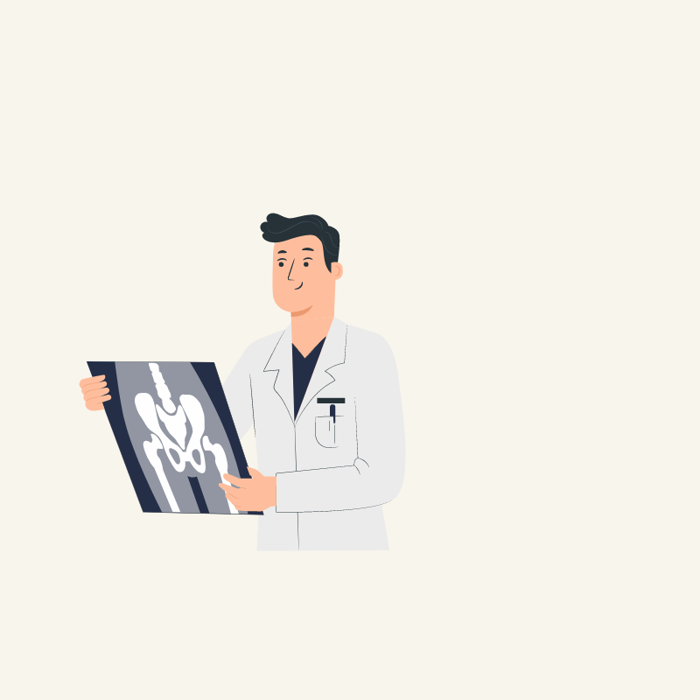

Unified Medical System
Ms. Jetty Benjamin Devadethan R
Assistant Professor AJC20MCA-I029

Slide 2
Contents
01
Abstract
02
Users
03
Implementation
04
Modules
05
UML Diagrams
06
Conclusion

Slide 3
Abstract
The Unified Medical System (UMS) is a comprehensive digital healthcare platform designed to revolutionize India's healthcare landscape. By integrating patient portals, provider portals, a centralized data platform, and an AI-powered chatbot, UMS aims to improve patient access, streamline provider interactions, and enhance public health monitoring. A key feature of UMS is its ability to detect potential disease outbreaks early through machine learning analysis of patient symptoms, enabling timely public health interventions. The platform's robust tech stack, including Jinja, DaisyUI, Bootstrap Flask, and MongoDB, ensures scalability, security, and user-friendliness. By prioritizing patient empowerment and data privacy, UMS empowers patients to manage their health information securely while facilitating seamless data exchange between healthcare providers. With its focus on accessible, informed, and proactive healthcare, UMS is poised to strengthen India's healthcare infrastructure and drive positive health outcomes for its diverse population.

Slide 4
USERS!

Slide 5

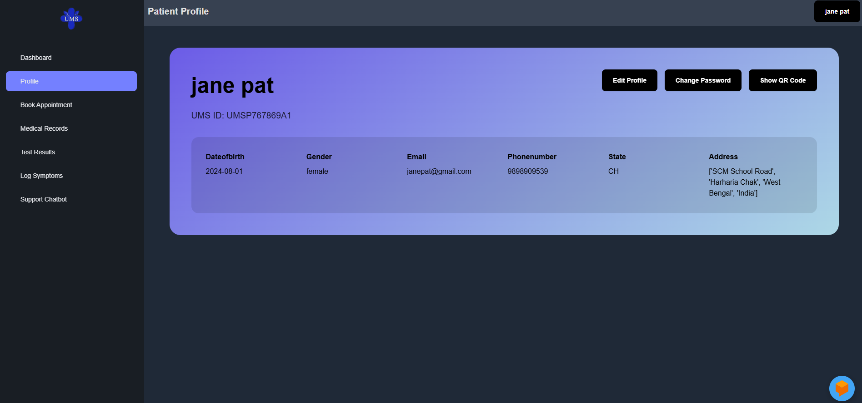
01
PATIENT

Slide 6
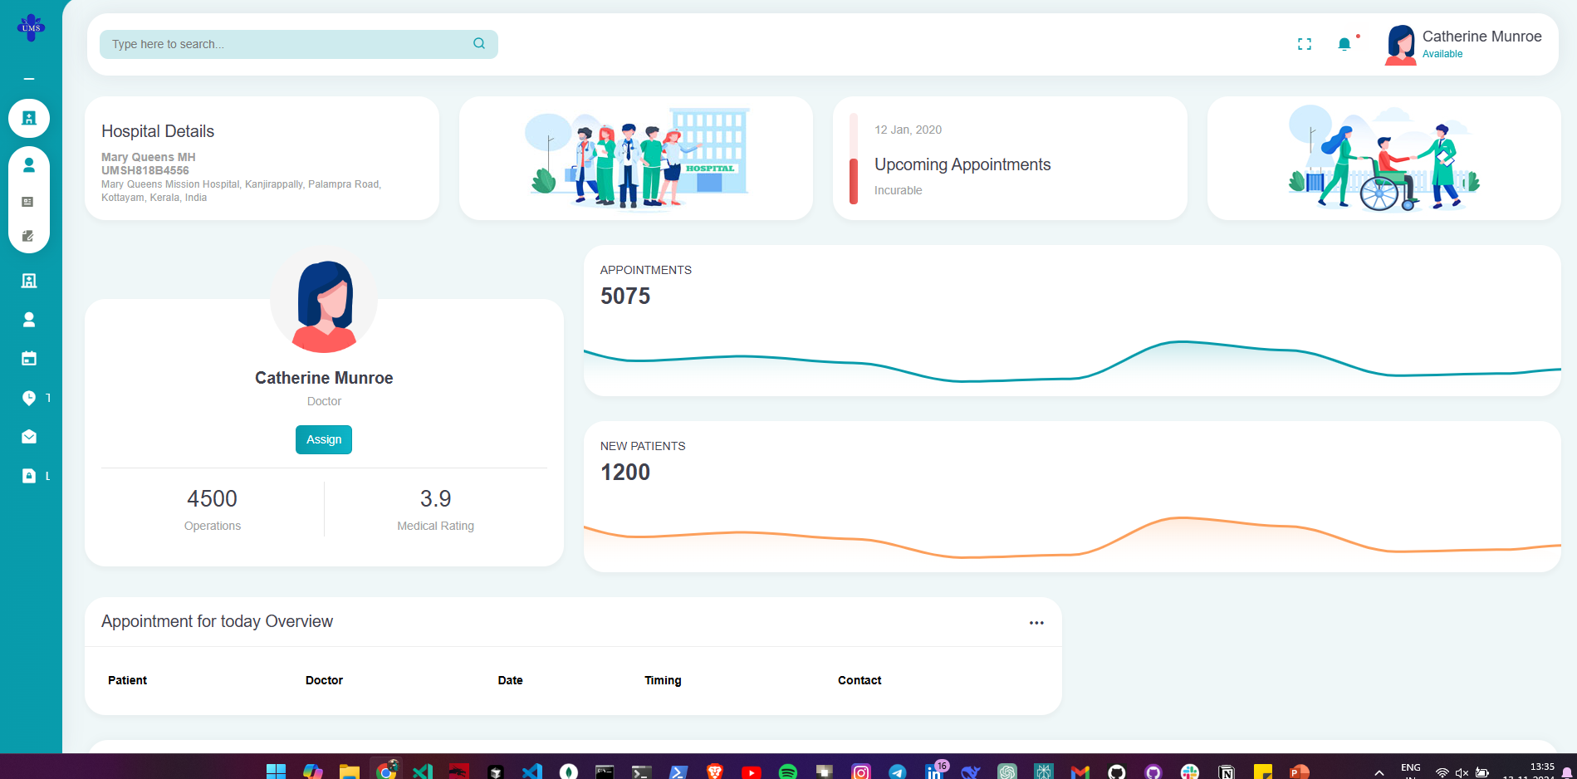
DOCTOR
02

Slide 7

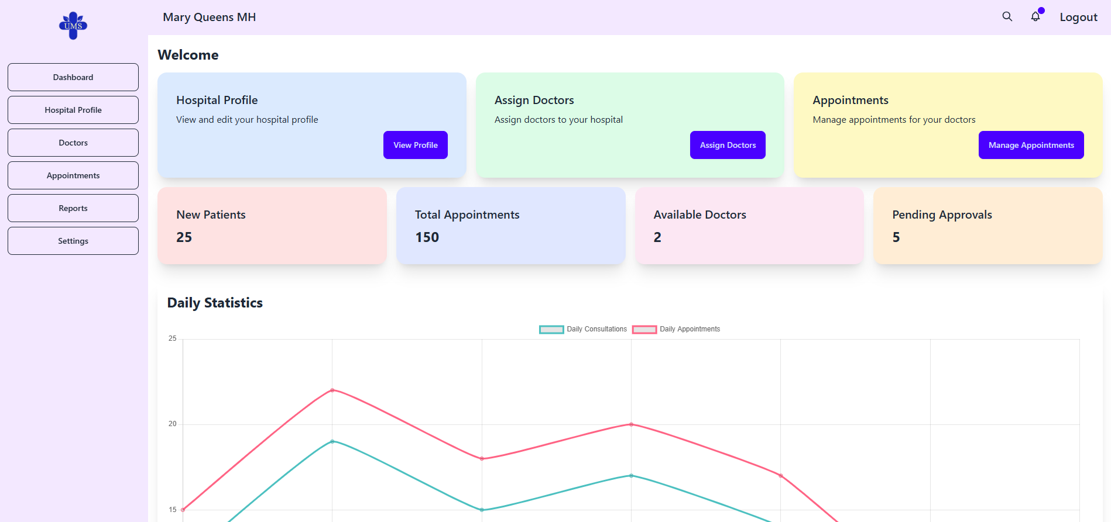
03
HOSPITAL

Slide 8

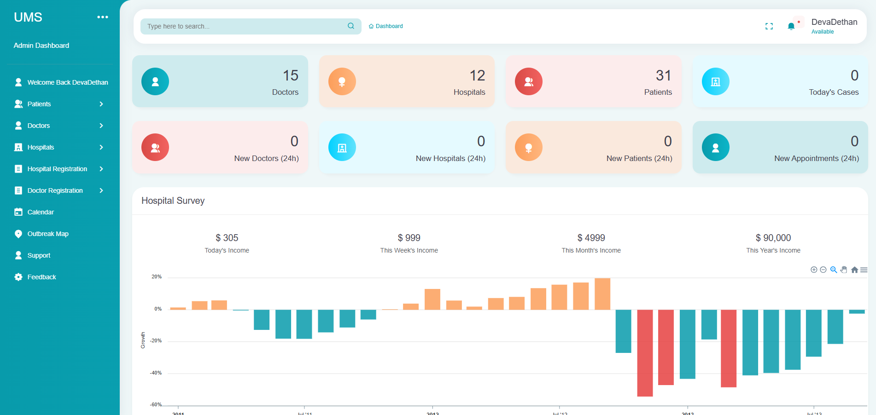
04
ADMIN

Slide 9
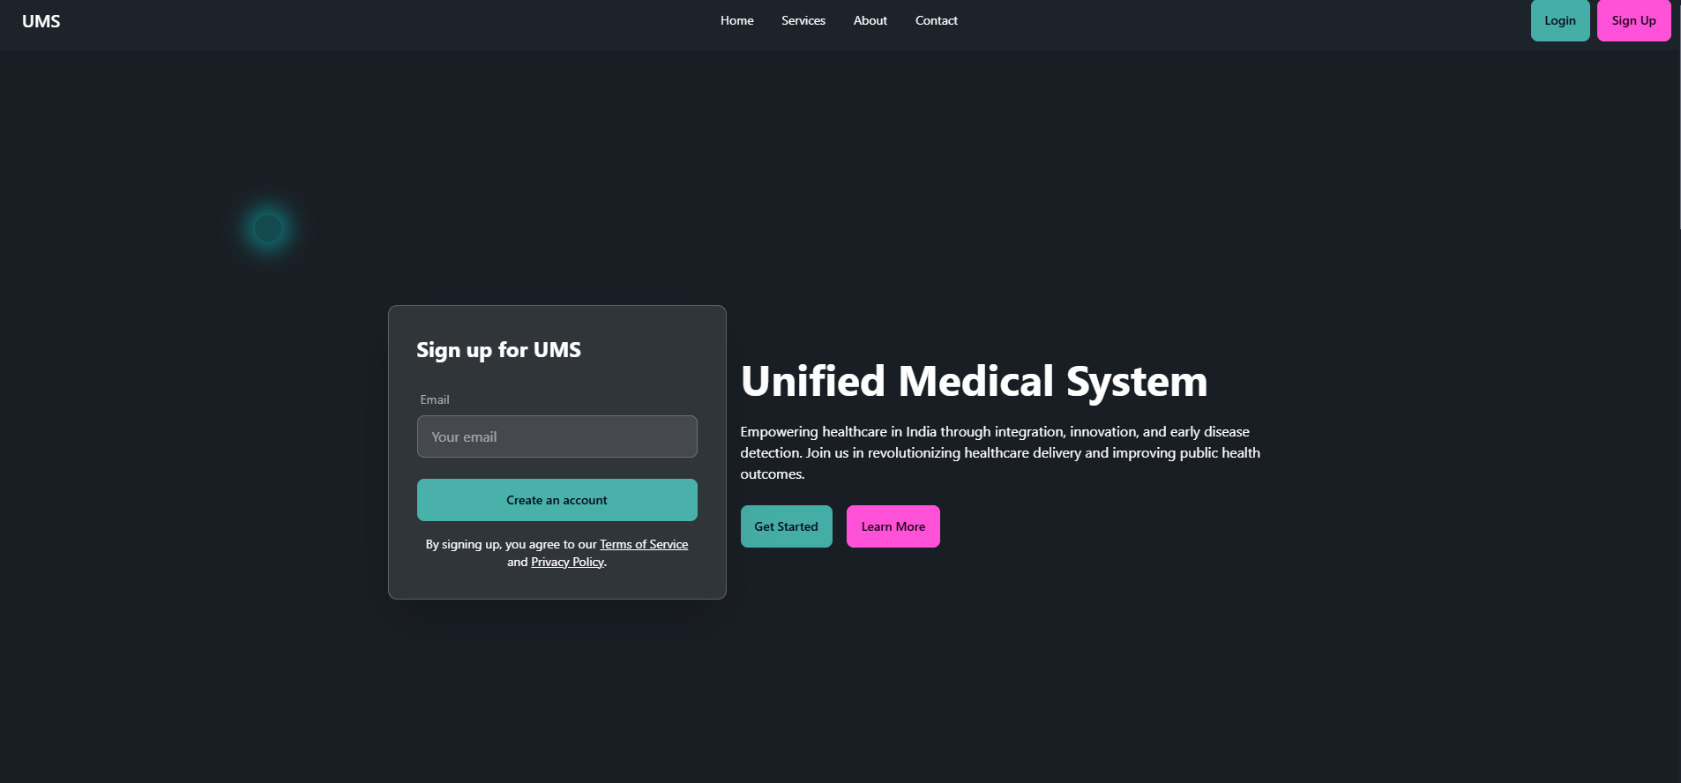
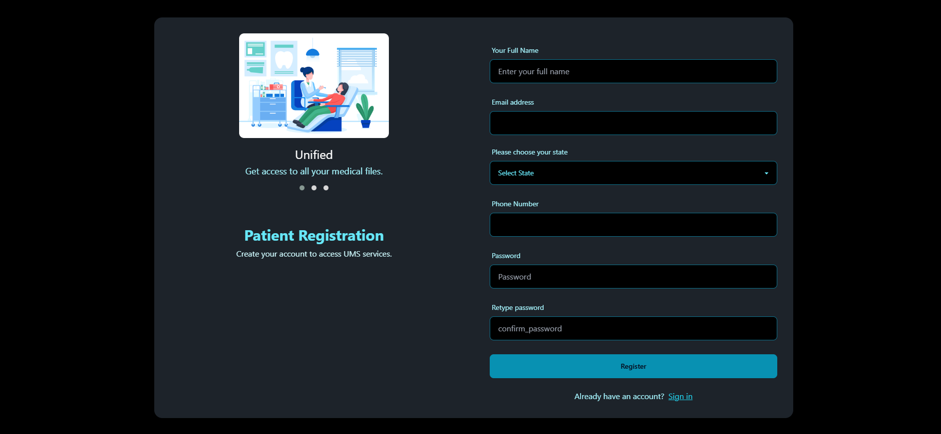
UMS
Home Page
Register

Slide 10
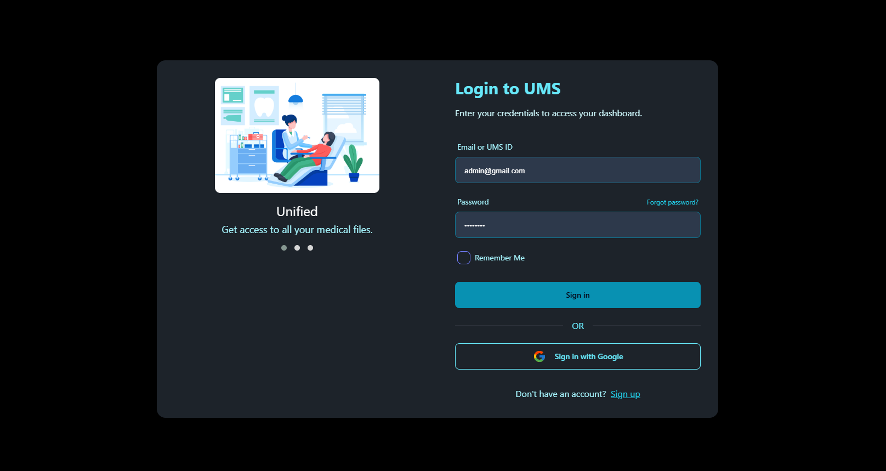
Login
Admin Dashboard

Slide 11
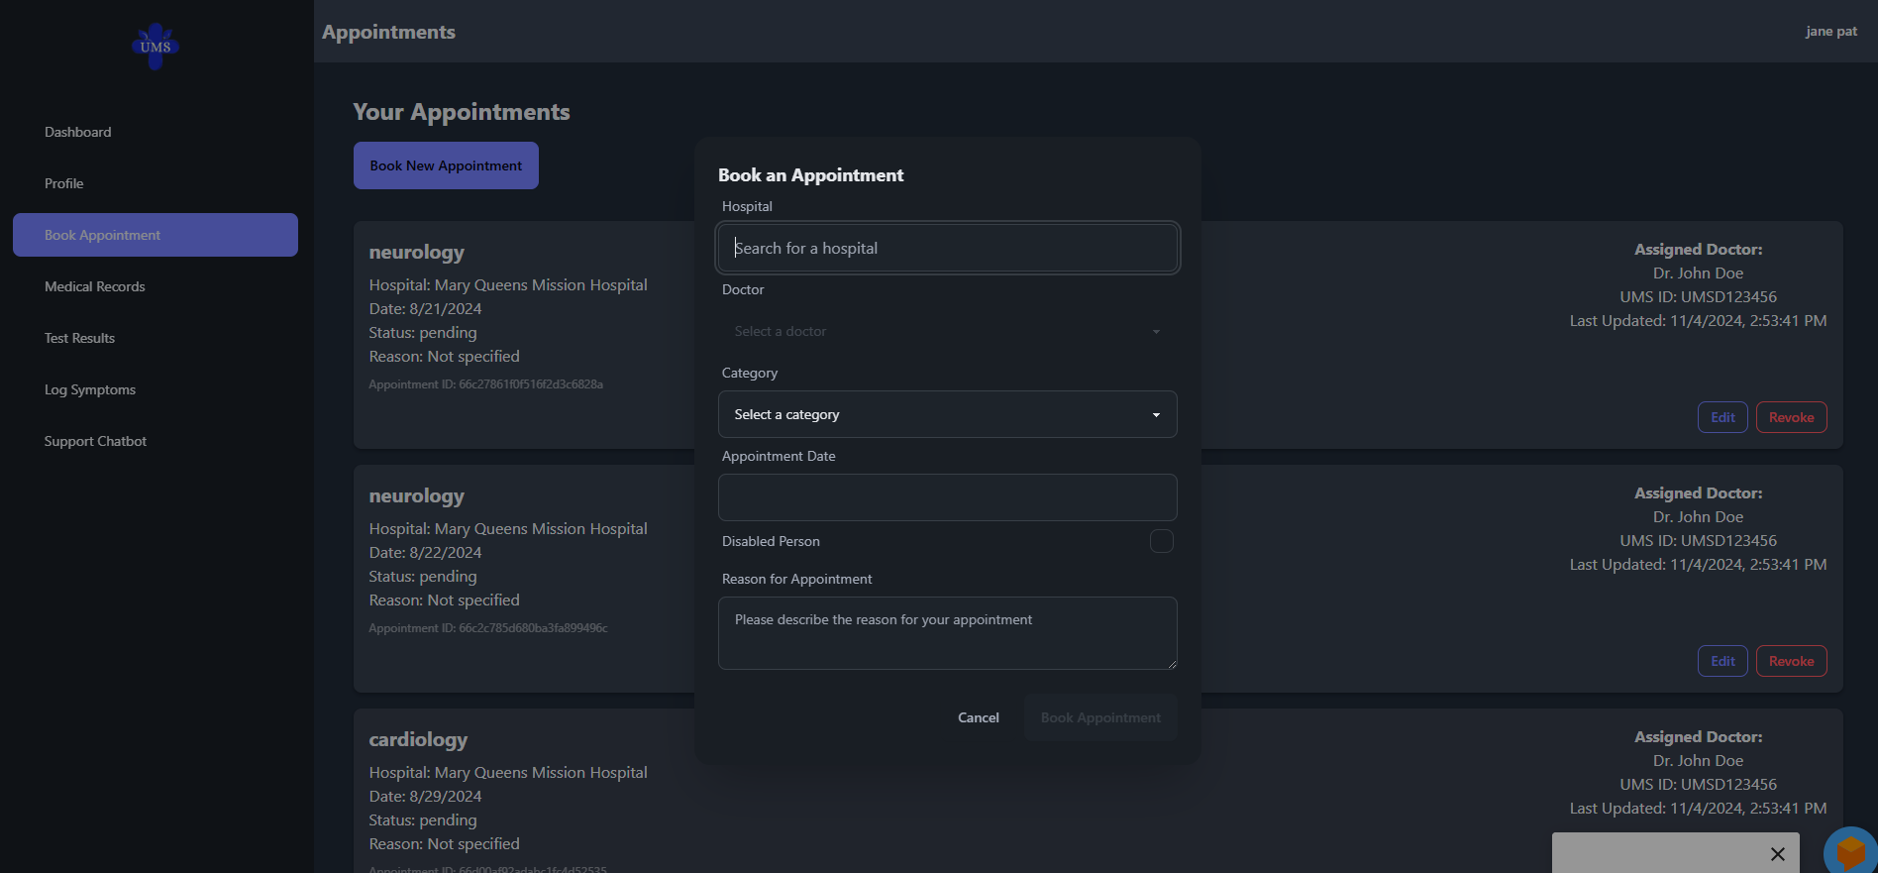
Appointment Booking
Patient Profile

Slide 12
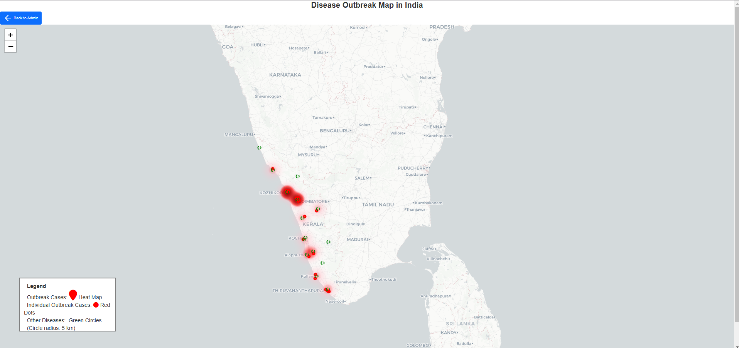
Hospital Dashboard
Outbreak Detection

Slide 13

Implementation
The early disease outbreak detection in the UMS project uses real-time data to identify and alert on potential outbreaks, helping healthcare providers respond quickly to prevent spread and manage resources efficiently.

Slide 14
Early disease outbreak detection

Slide 15
Modules

Slide 16
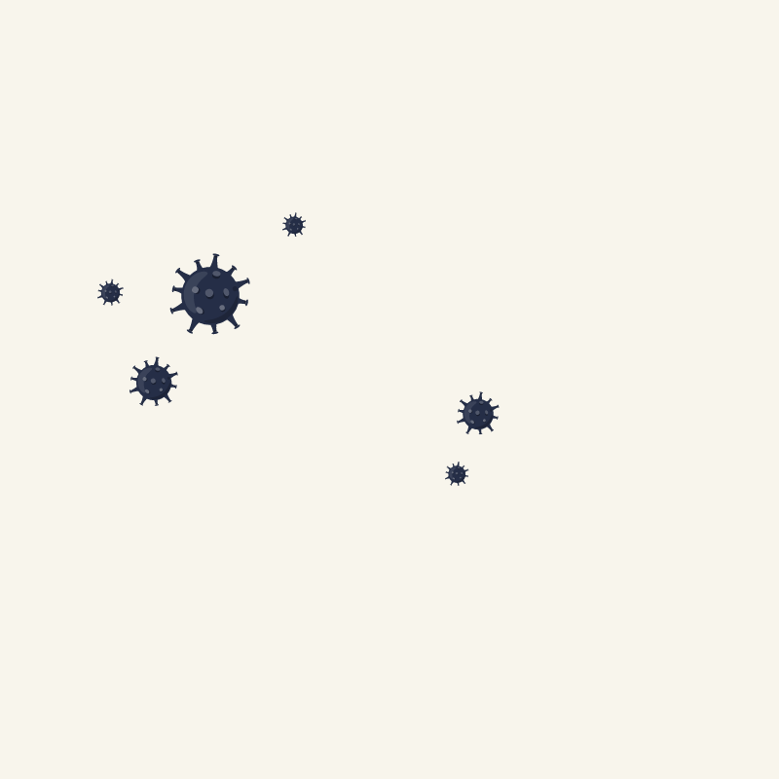
Patient Portal
Outbreak Detection Module
This module enables patients to register, log in, book, and manage appointments. It provides secure access to personal medical records like prescriptions, lab results, and medical history. Patients can also download medical certificates and log symptoms, aiding in disease outbreak detection.
This module analysis the logged symptoms with the RoBERTa model and with Folium we the visualization of the heatmap is done and can be used to analyze early outbreak detection using heatmap spots.
Unified Health Data Platform
This centralized platform standardizes and securely stores medical records, enabling seamless data exchange across the patient and healthcare provider portals, along with the disease outbreak detection module. It includes user authentication and authorization for secure access.

Slide 17
UML Diagrams

Slide 18
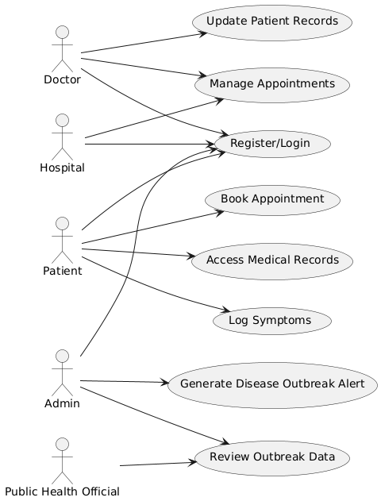
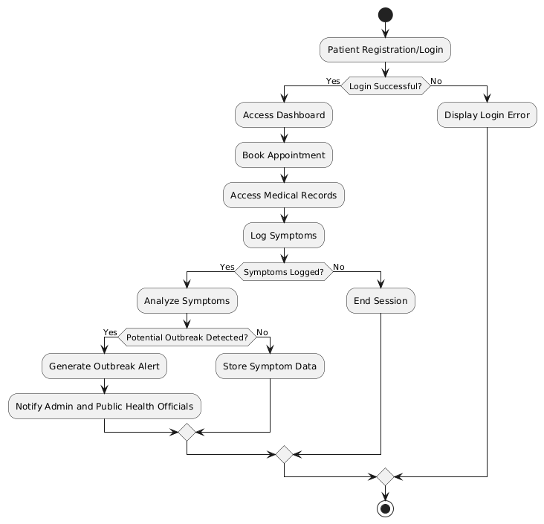
Use Case Diagram
Activity Diagram

Slide 19
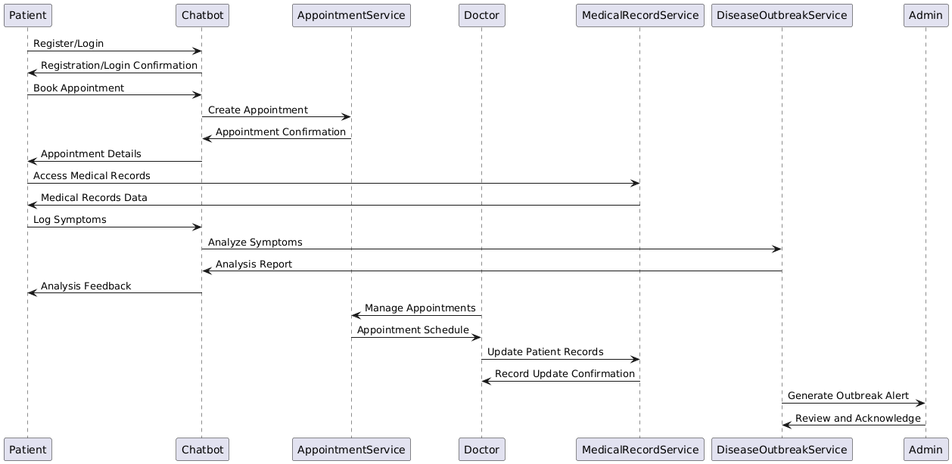
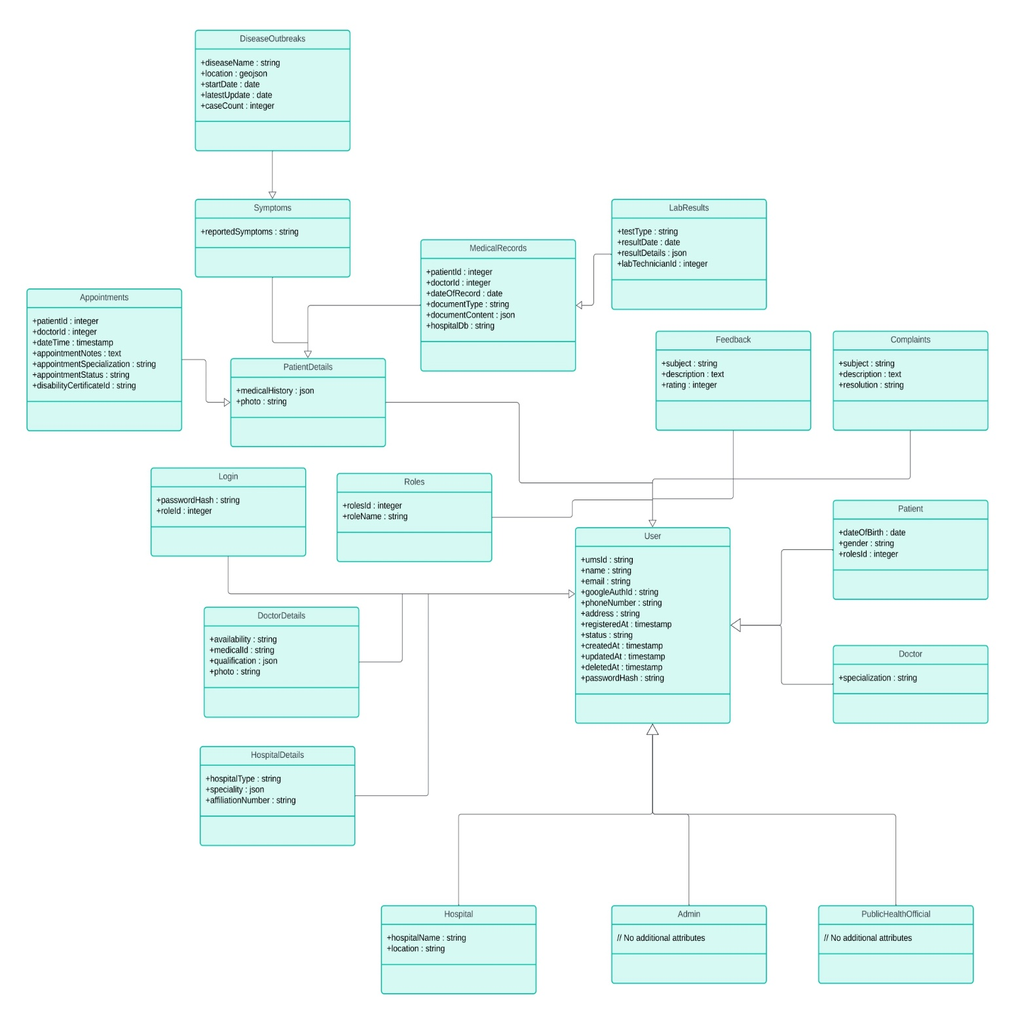
Sequence Diagram
Class Diagram

Slide 20
Conclusion
The UMS project provides a comprehensive, secure, and integrated solution for healthcare management, enabling seamless communication between patients and providers. With advanced features like data-driven disease outbreak detection and unified health data access, it empowers stakeholders to improve care delivery, enhance data security, and proactively manage public health challenges.

Slide 21
Thanks

